Slide 1
Practical Deep Learning for Computer Vision
Ibraheem Alhashim
Visual Computing Center

Slide 2

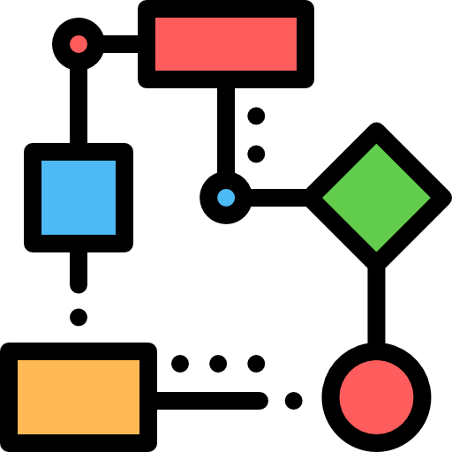


AGENDA
Basics of ML & Deep Learning
Architectures & Frameworks
Building an Object Recognition Application
Applying Deep Learning to Your Work

Slide 3
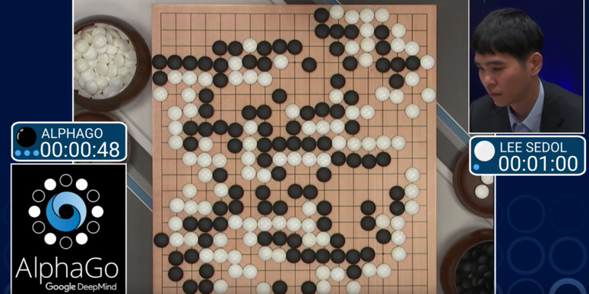
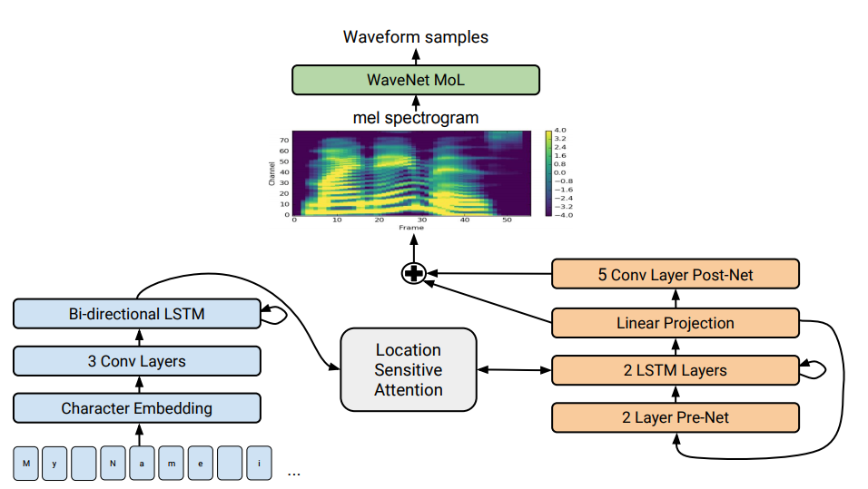
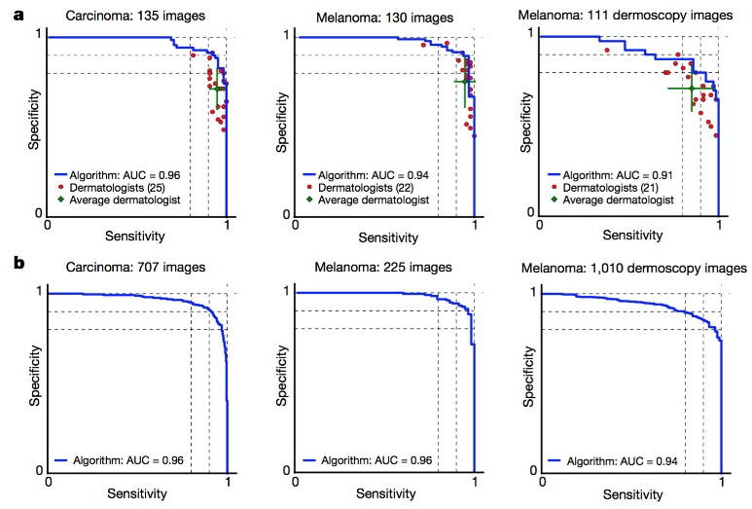
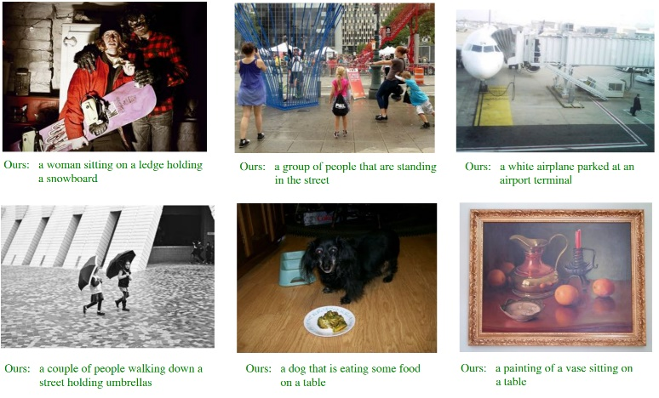
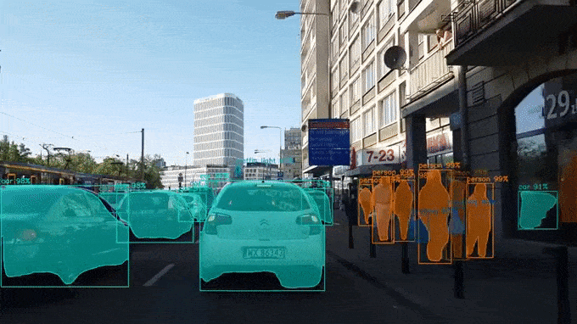

DEEP LEARNING
AlphaGo: beating top Go players
(Google DeepMind)
Human-like Speech from Text
(Google Brain)
Classification of skin cancer
(Stanford University)
Unpaired Image-to-Image Translation
(UC Berkeley)
Deep Learning-based Image Captioning
(Snap Inc.)
Object Detection and Segmentation
(Facebook AI)

Slide 4

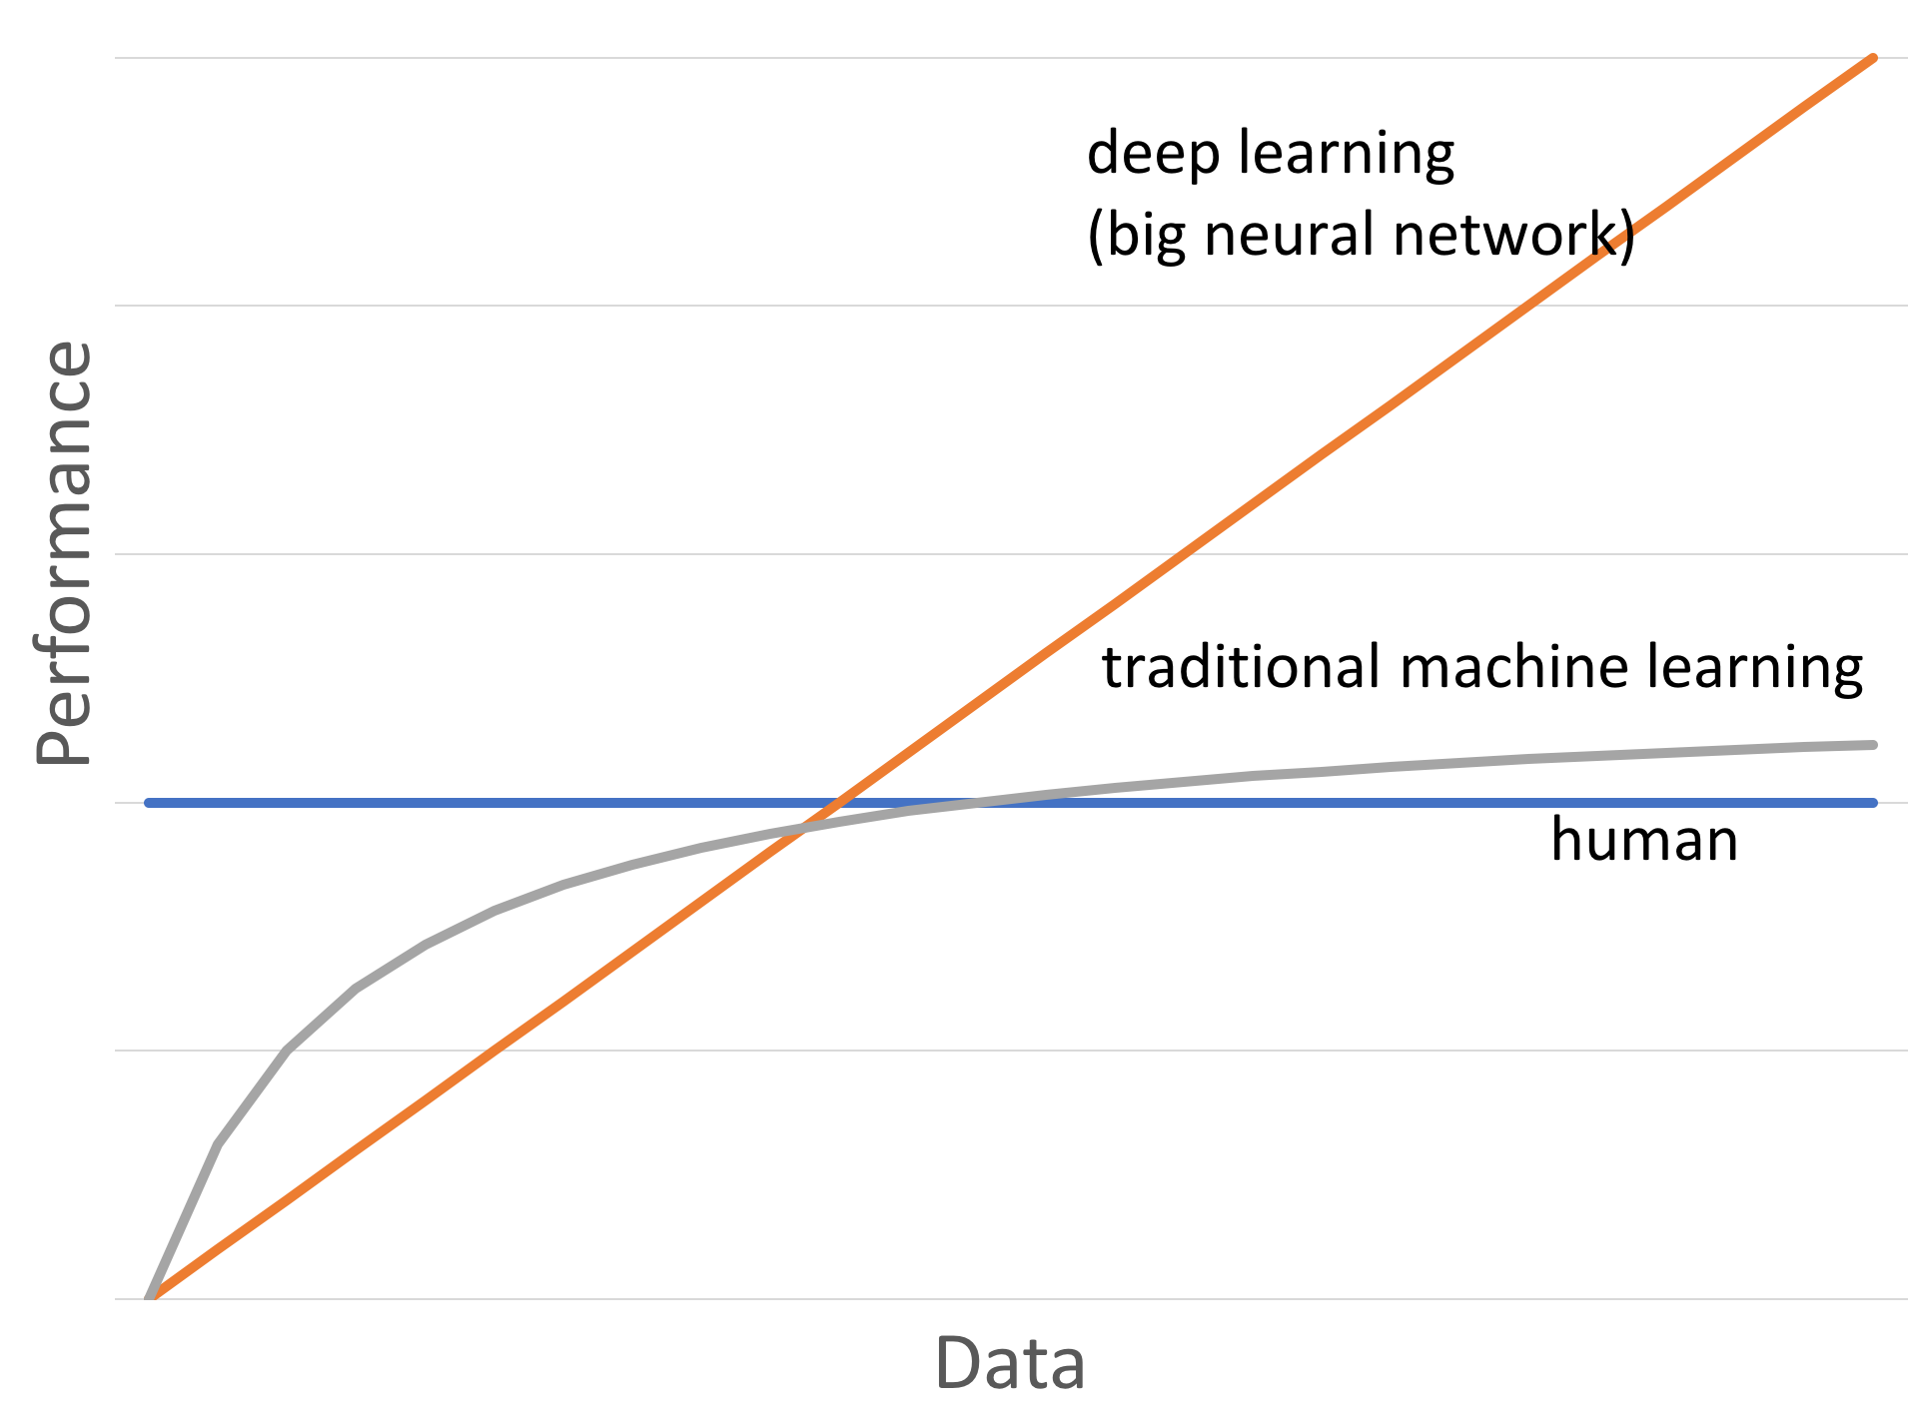
MACHINE LEARNING

Slide 5
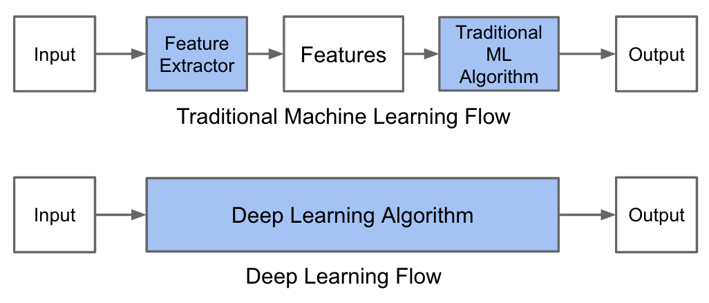
MACHINE LEARNING
Very difficult
More hands-off

Slide 6
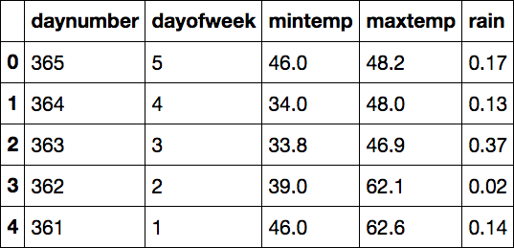

MACHINE LEARNING

Slide 7
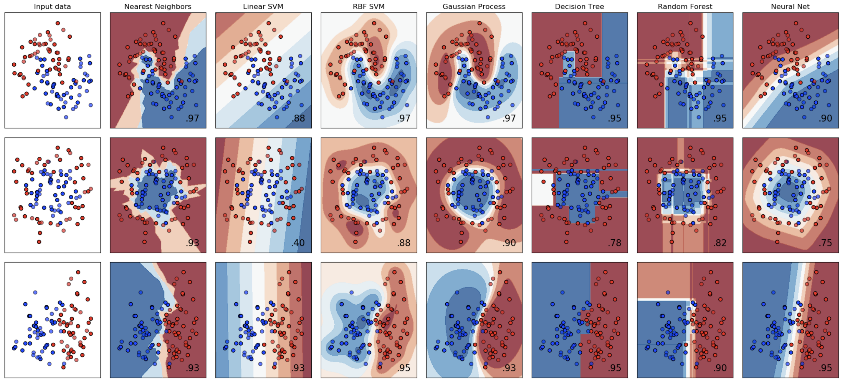
MACHINE LEARNING

Slide 8
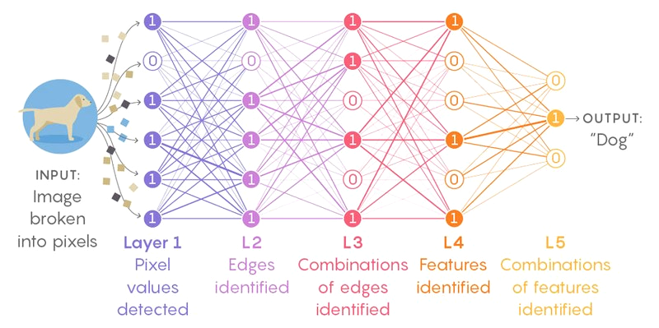
DEEP LEARNING
Deep Neural Networks: multiple layers of nonlinear processing units for feature extraction and transformation
https://playground.tensorflow.org

Slide 9
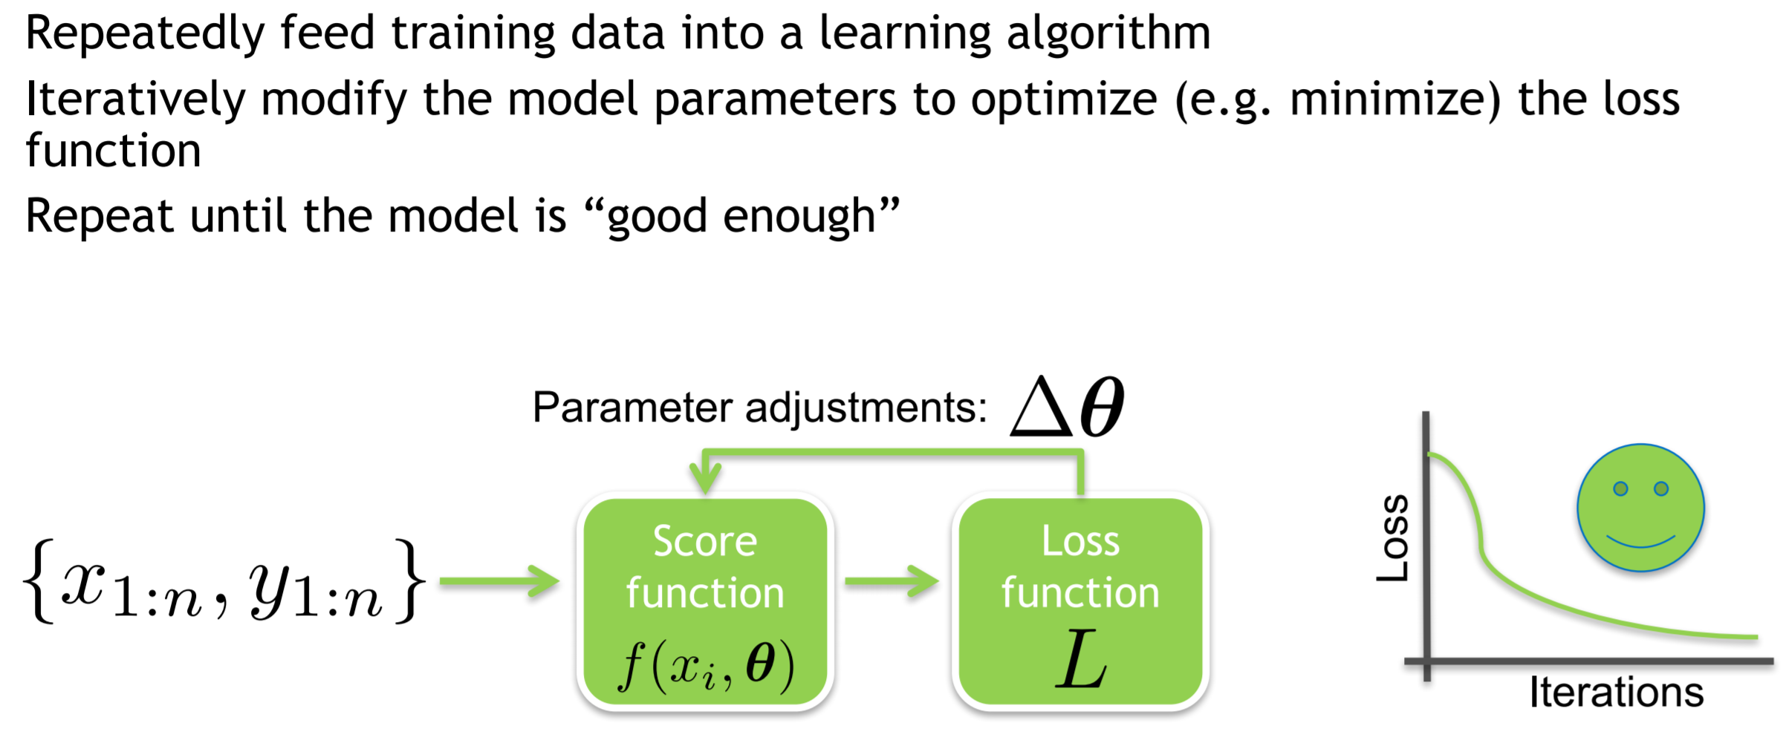
MACHINE LEARNING BASICS

Slide 10

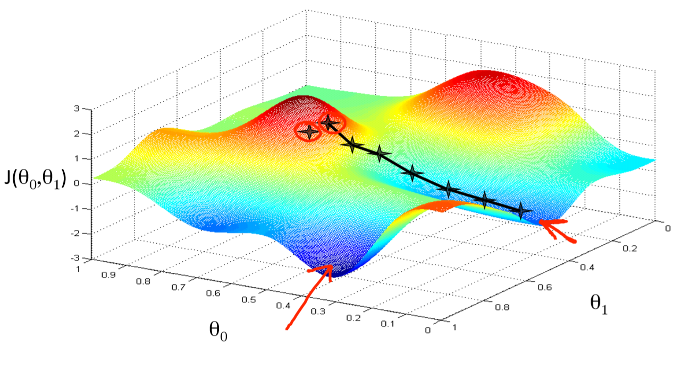
MACHINE LEARNING BASICS
Gradient descent

Slide 11

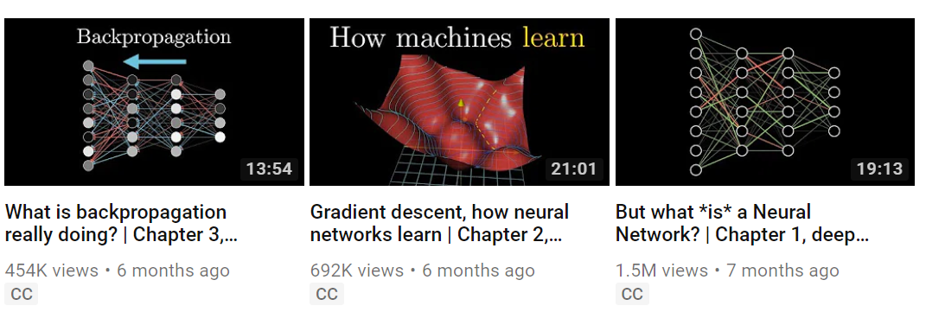
DEEP LEARNING RESOURCES
Excellent videos (20 min each)

Slide 12

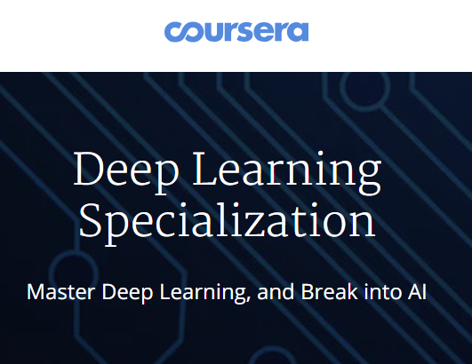
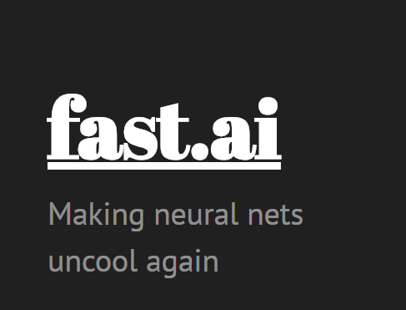
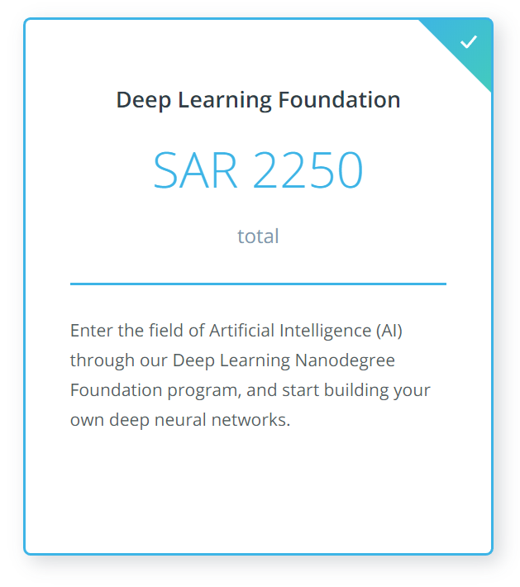
DEEP LEARNING RESOURCES
Online Courses
Projects
Certificate
Support
High price
Projects
Certificate
Mid price
Applied
State of the art
Support
Free!

Slide 13

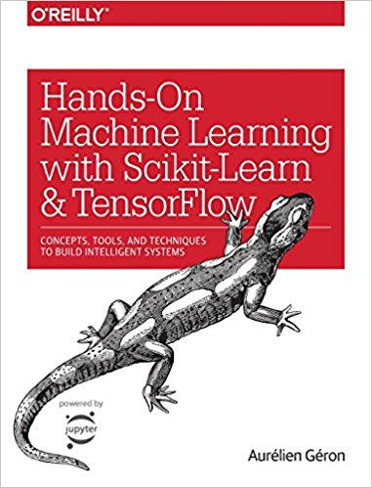
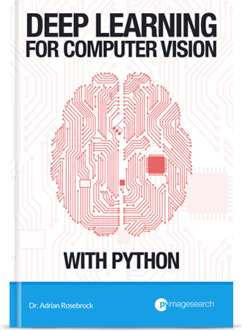
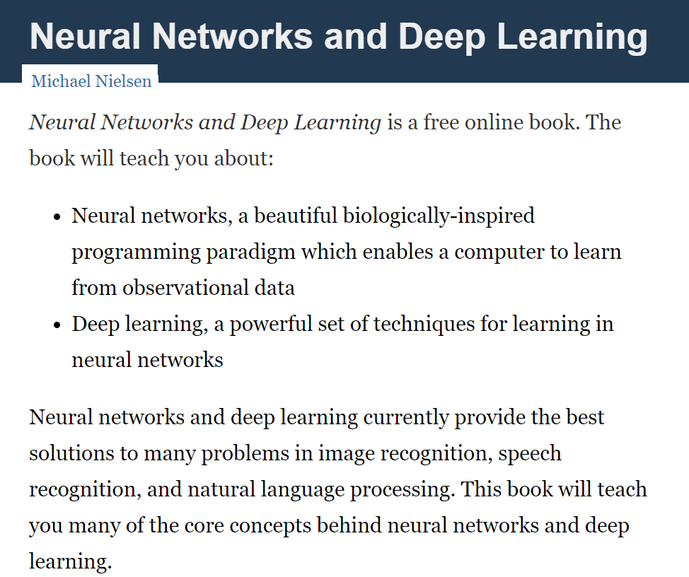
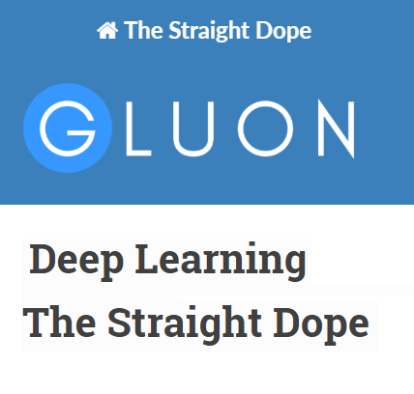
DEEP LEARNING RESOURCES
Textbooks

Slide 14
DEEP LEARNING RESOURCES
Other online sources
https://www.reddit.com/r/MachineLearning
https://github.com/
https://medium.com/tag/deep-learning
https://distill.pub
https://twitter.com/ylecun
https://twitter.com/AndrewYNg
https://twitter.com/karpathy

Slide 15

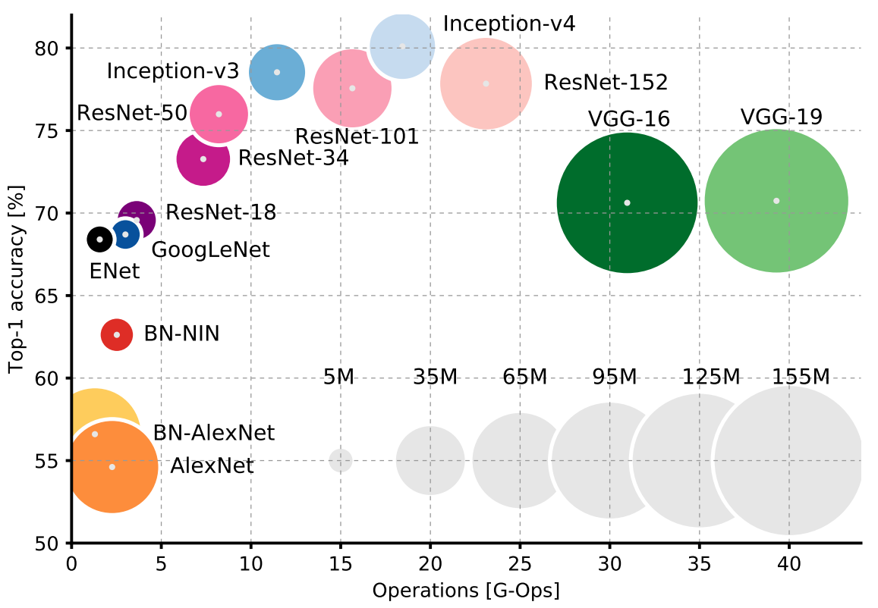
ARCHITECTURES
Big bang!
(2012)

Slide 16
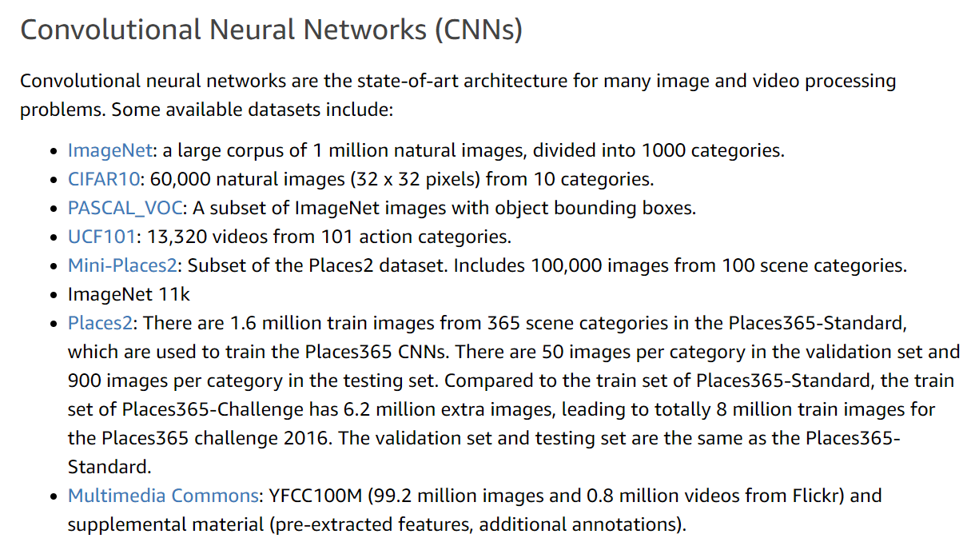
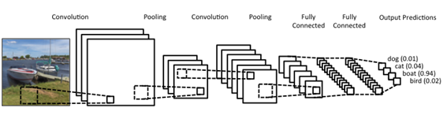
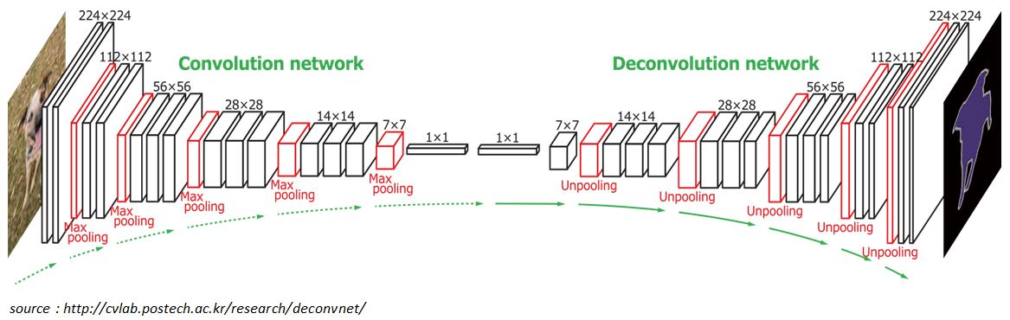
ARCHITECTURES

Slide 17

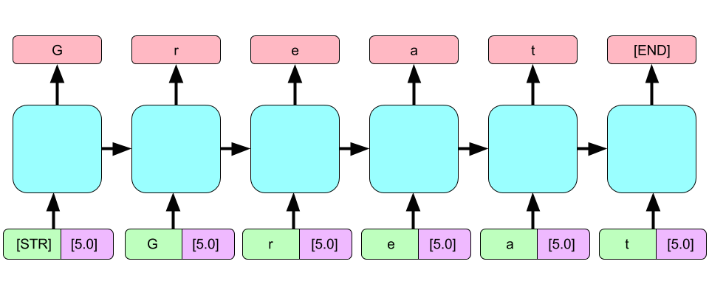
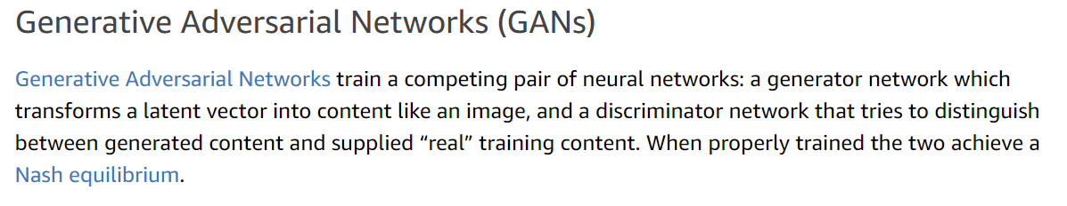
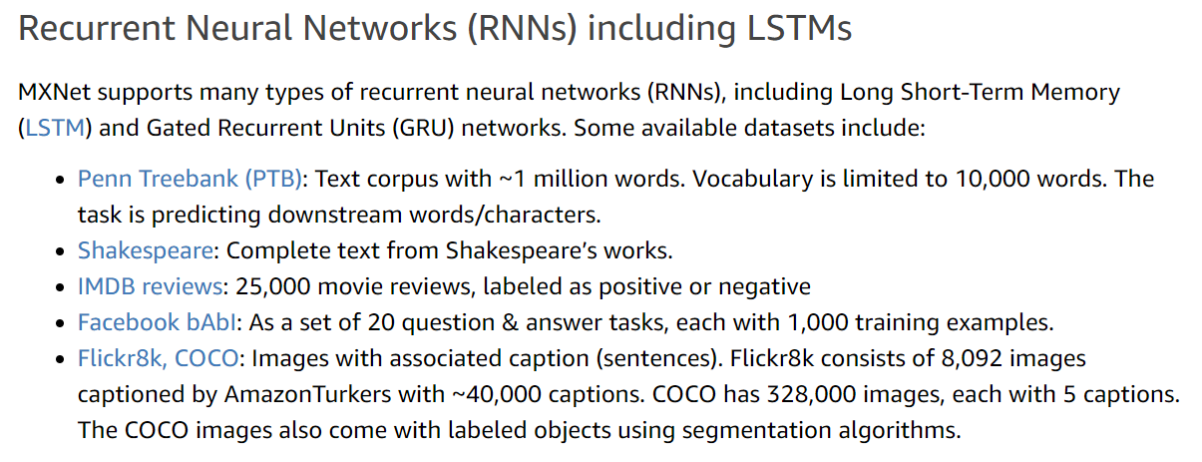
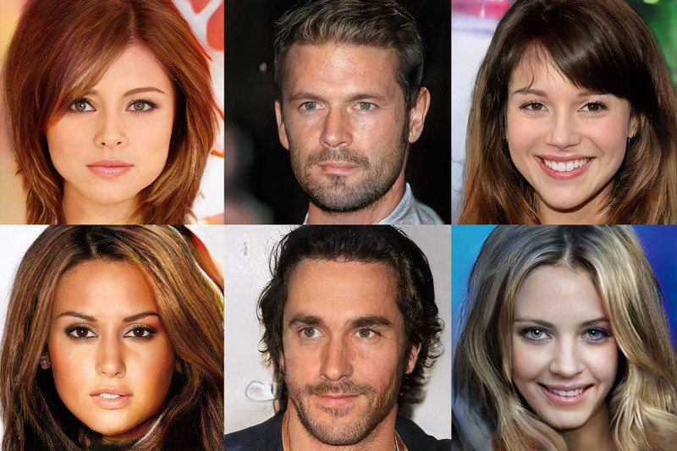
ARCHITECTURES

Slide 18
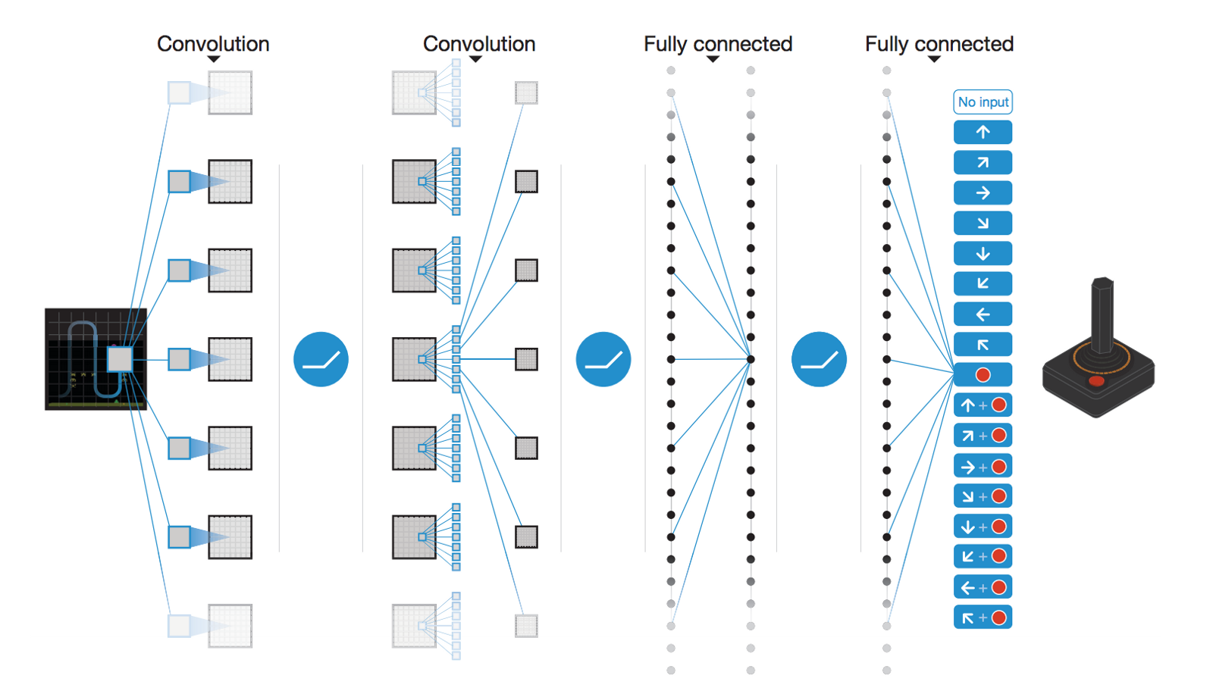
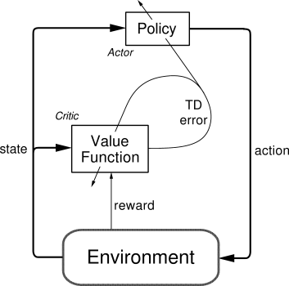
ARCHITECTURES
Reinforcement Learning
https://yanpanlau.github.io/2016/10/11/Torcs-Keras.html
http://amid.fish/reproducing-deep-rl

Slide 19
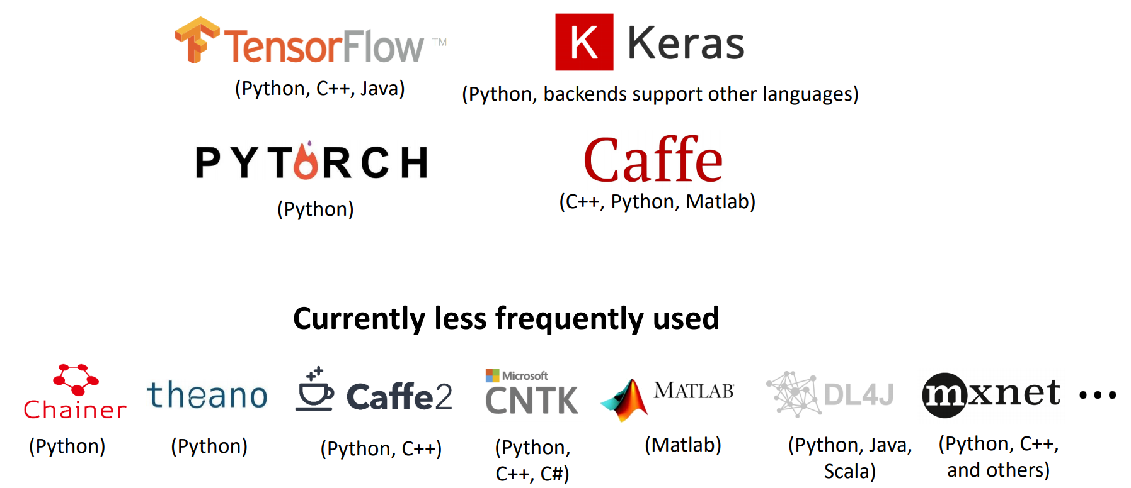
FRAMEWORKS

Slide 20
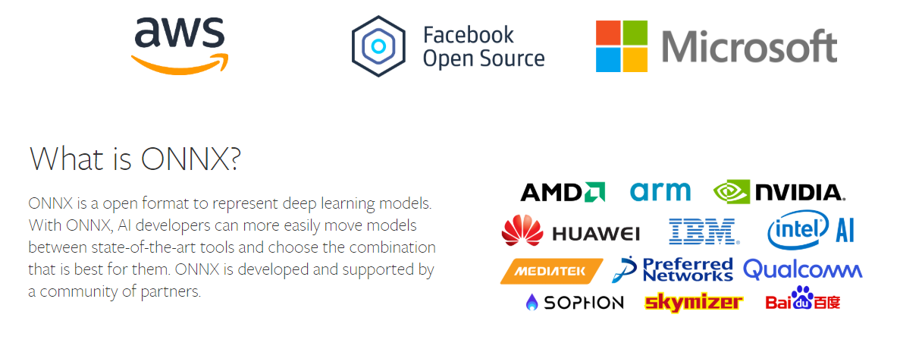
FRAMEWORKS
Conversion
https://github.com/ysh329/deep-learning-model-convertor
ONNX

Slide 21
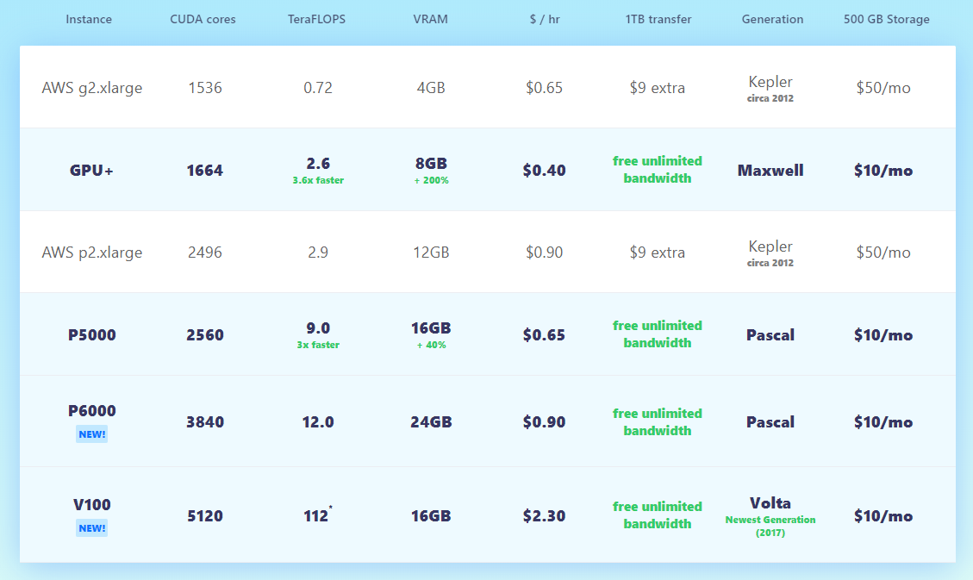
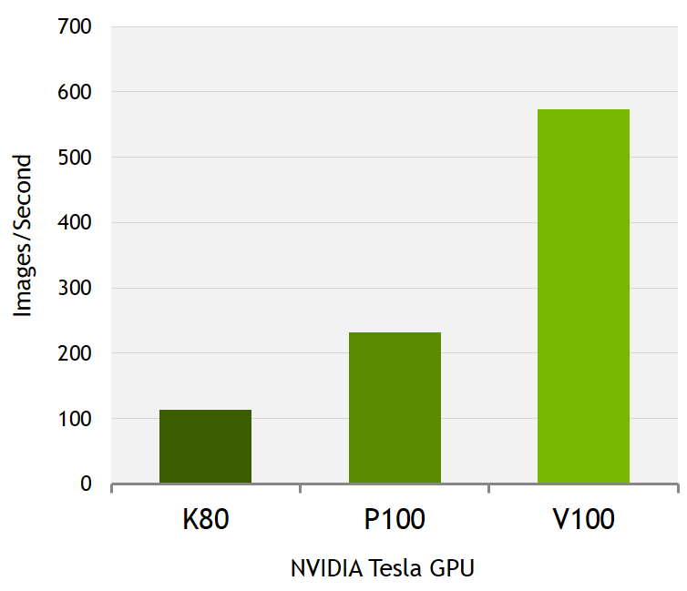
RESOURCES
The cost of DL
https://dawn.cs.stanford.edu/benchmark/
Solutions

Slide 22


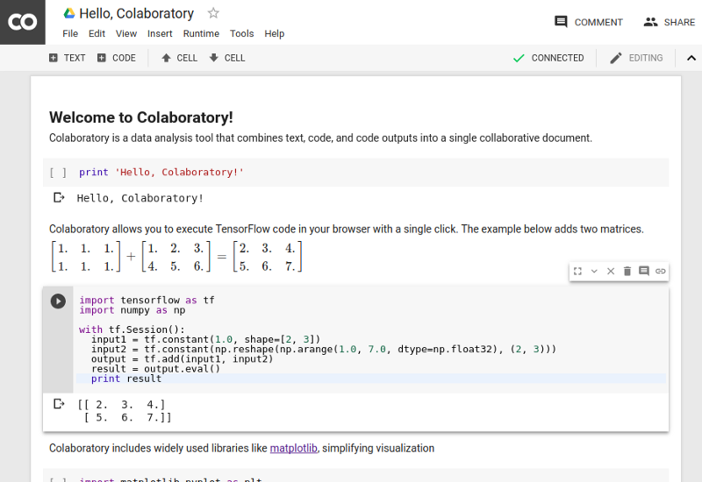
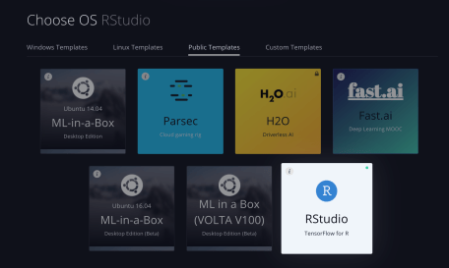
SOLUTIONS

Slide 23
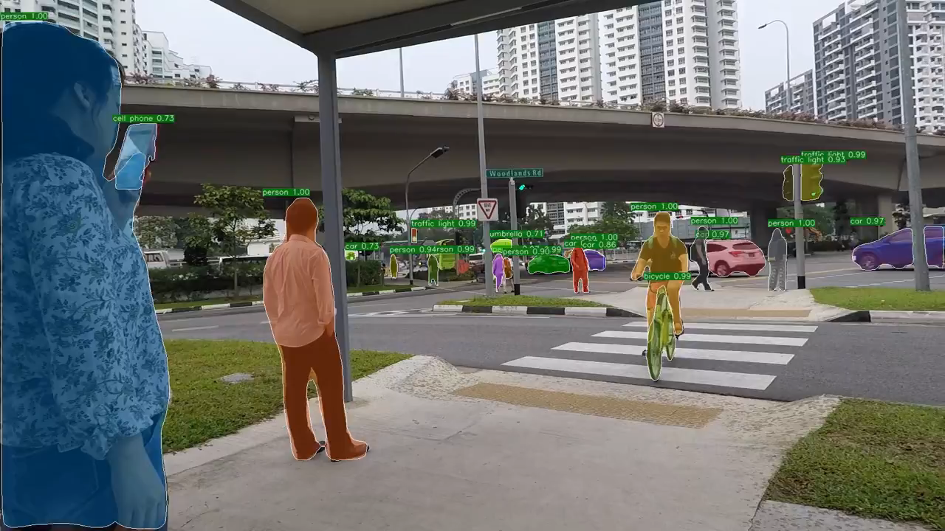
OBJECT RECOGNITION

Slide 24
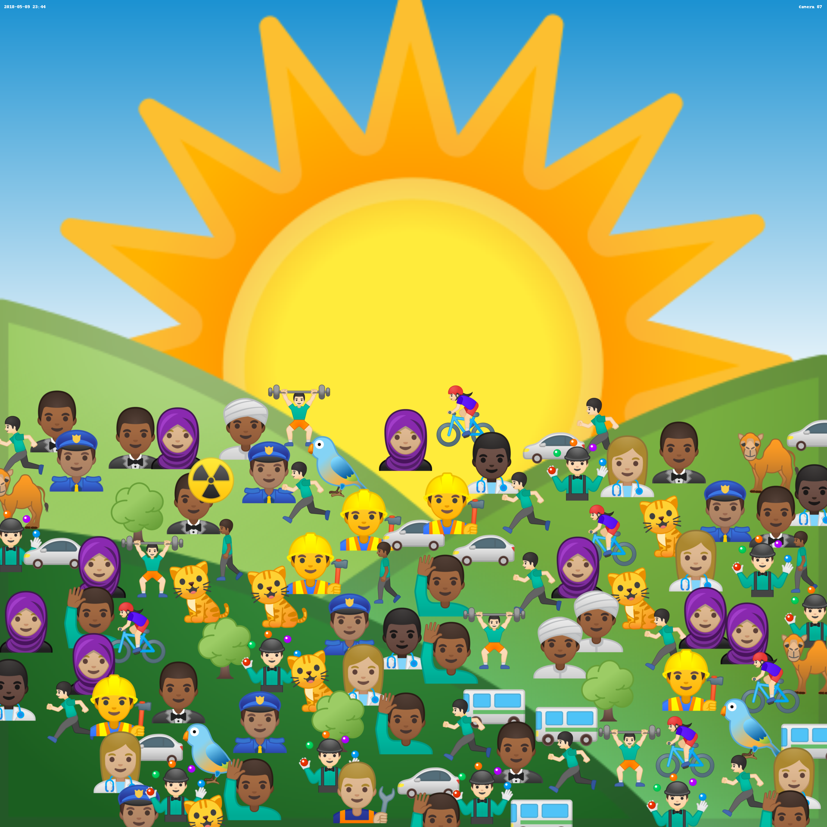
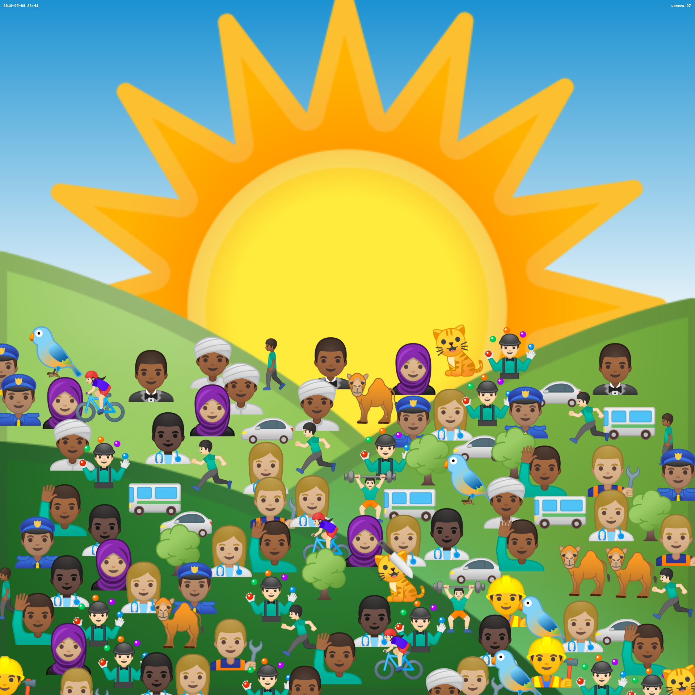

Slide 25







PROBLEM

Slide 26
Exercise https://github.com/ialhashim/emojinettutorial

Slide 27

ARCHITECTURE

Slide 28
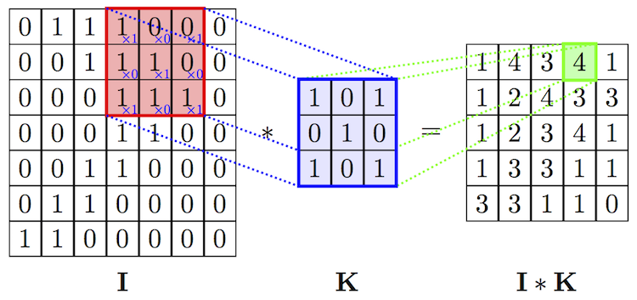

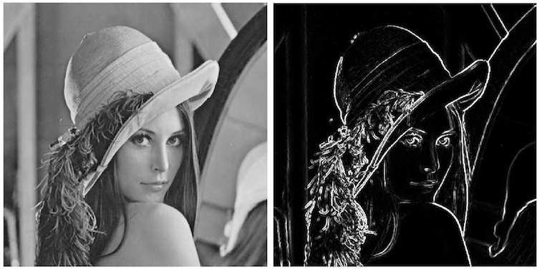
LAYERS

Slide 29
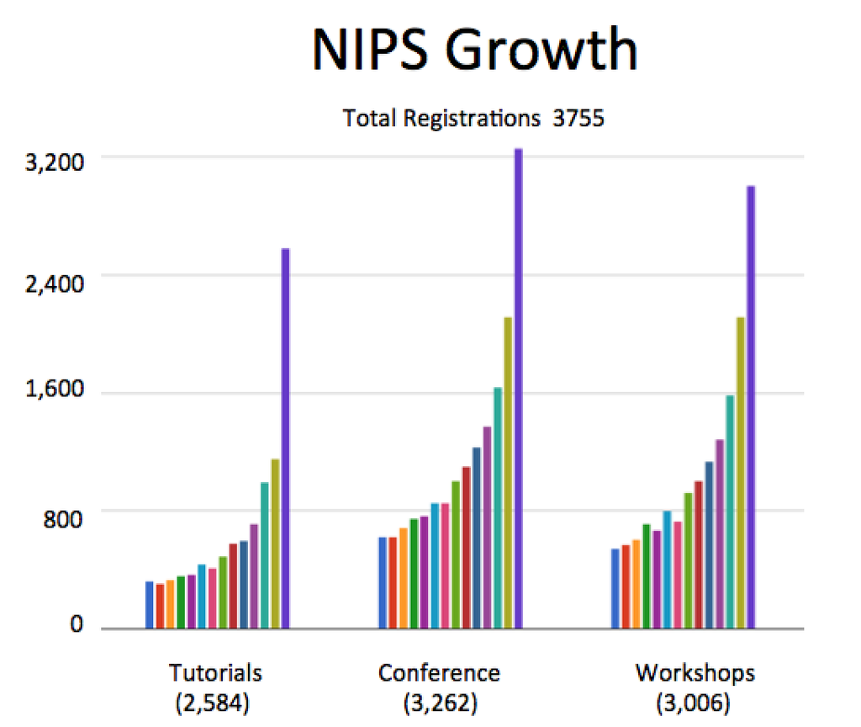
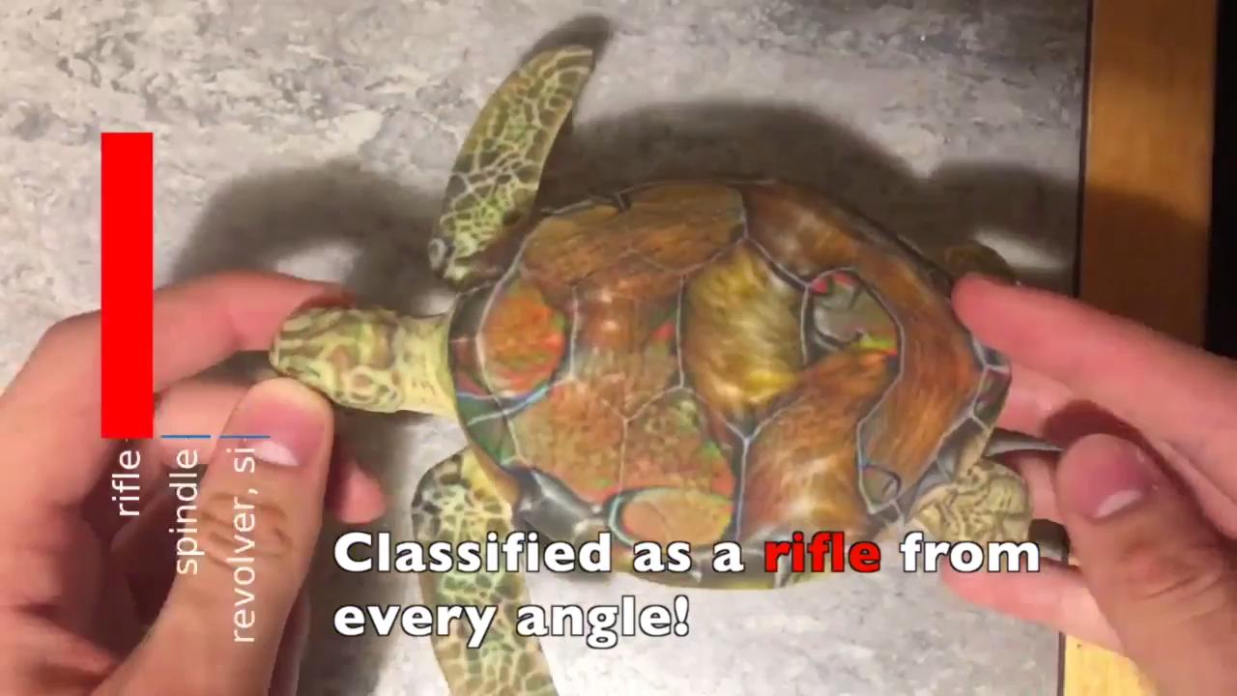
Applying Deep Learning to Your Work
Keep up with the latest trends
Field is changing at crazy speeds!
Big data can be a deal breaker
Adapt other datasets
Synthesize you own
Resource management: time and money
Do not reinvent the wheel
Smallest working network, be ready to start all over
Limitations of DNN
Generalization
Type of problems
Viability

Slide 30
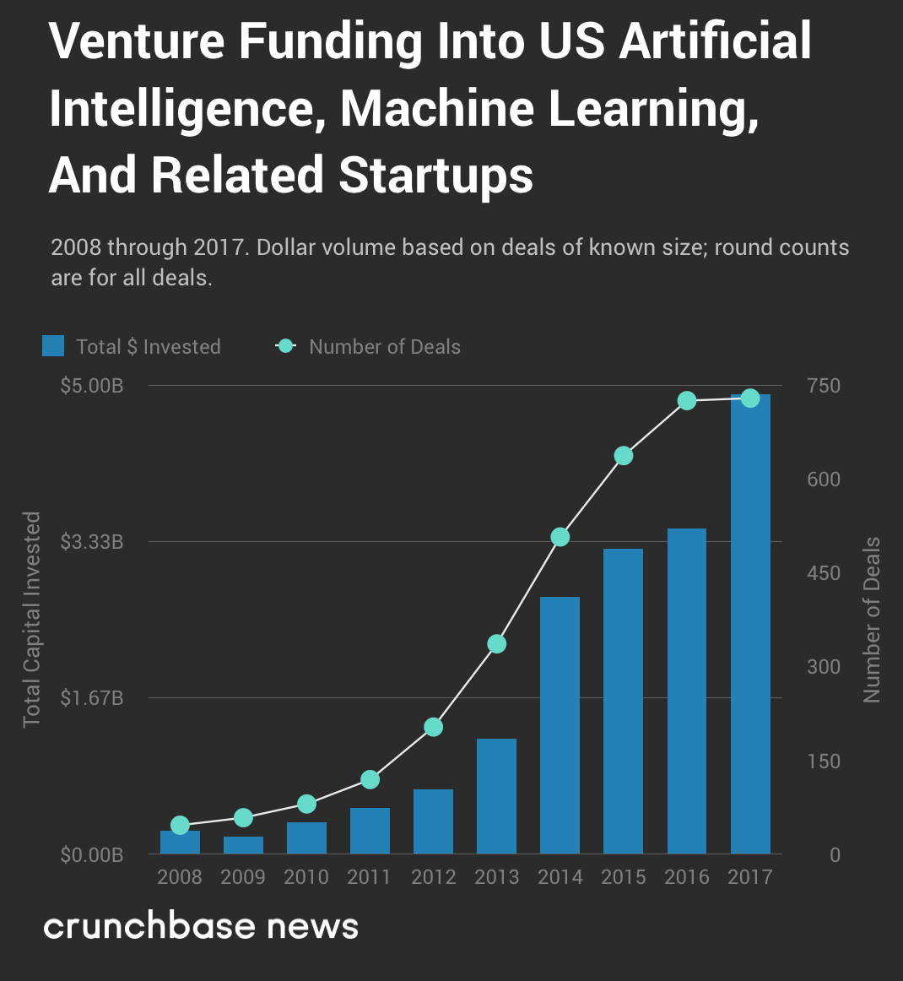
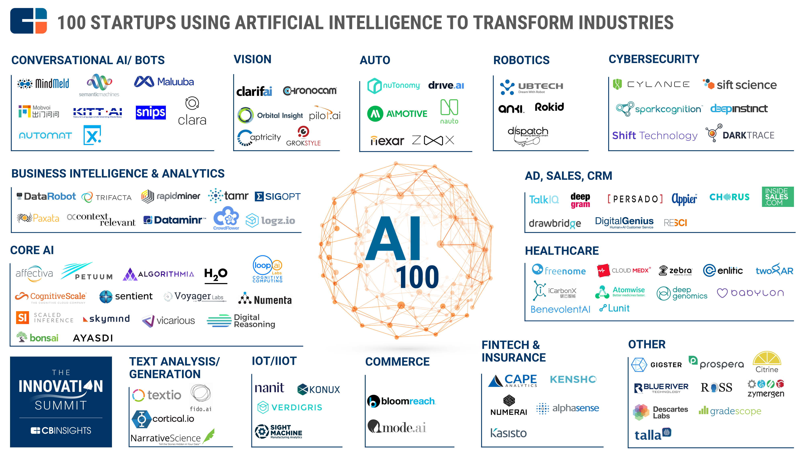
FUTURE PROSPECTS

Slide 31

Thank you
Questions?

